Slide 1
Chapter 4: Group Leadership

Slide 2
Manager vs Leader
Management
1. Planning
2. Organizing
3. Staffing – leading
4. Controlling

Slide 3
On board 1. What makes a good leader? Opinion , talent, charisma, cool, generous, huge contribution, will, optimistic, decisive, determine, logical, work hard, skillful. effort 2. What kind of power is required for a leader?

Slide 4
Leaders and Leadership
Leadership
The ability to make strategic decisions and use communication effectively to mobilize group members toward
achieving a common goal
A leader is a person.
Leadership is a behavior.

Slide 5
Leadership and Power
Power is “the quality without which leaders cannot lead.”
Power is the ability or authority to influence and motivate others.
Warren Bennis and Bruce Nanus
Leaders: The Strategies for Taking Charge

Slide 6
Types of Position Power
Legitimate Power – Relies on a job title or duty
Reward Power – Controls and gives out valued resources
Coercive Power – Controls and deals out sanctions and punishments
Informational Power – Controls and transmits information and resources

Slide 7
Buy me a coffee, I will pay for your coffee too.=> reward
Buy me a coffee or I will kick you. => coercive
Buy me a coffee, I will show u how to do homework.=> reward
Drink this coffee, this is 70%robusta mixed95% arabaca mixed 5% dried cherry mixed 30ml condensed milk. => expert
Drink this coffee, Mr. Linh loves this so you will love this too. => reference
Call hotline to fix the Ezcast. What kind of power HOTLINE has?
Call Mr. Nguyên to fix the EZcast. What kind of power Mr. Nguyên has?
Call Nguyên so he will call Mr. Kiếm to fix ezcast. What kind of power Nguyên has over thầy Kiếm?

Slide 8
Buy me a coffee, I will pay for your coffee too.REWARD
Buy me a coffee or I will kick you. COERCIVE
Buy me a coffee, I will show u how to do homework.INFORMATIONAL
Drink this coffee, this is 70%robusta mixed95% arabaca mixed 5% dried cherry mixed 30ml condensed milk. EXPERT
BẢO SAYS: Drink this coffee, Thục loves this so you will love this too.REFERENT, CHARISMATIC, PERSUASIVE
Call hotline to fix the Ezcast. What kind of power HOTLINE has? LEGITIMATE/INFORMATIONAL
Call Mr. Kiếm to fix the EZ cast. What kind of power Mr Kiếm has? EXPERT
Call SE Nguyên so he will call Mr. Kiếm to fix ezcast. What kind of power Nguyên has over thầy Kiếm? PERSUASIVE/LEGITIMATE
Phúc An play 2 hours games=> What kind of power do the game producer has over Phúc An.=> INFORM…

Slide 9
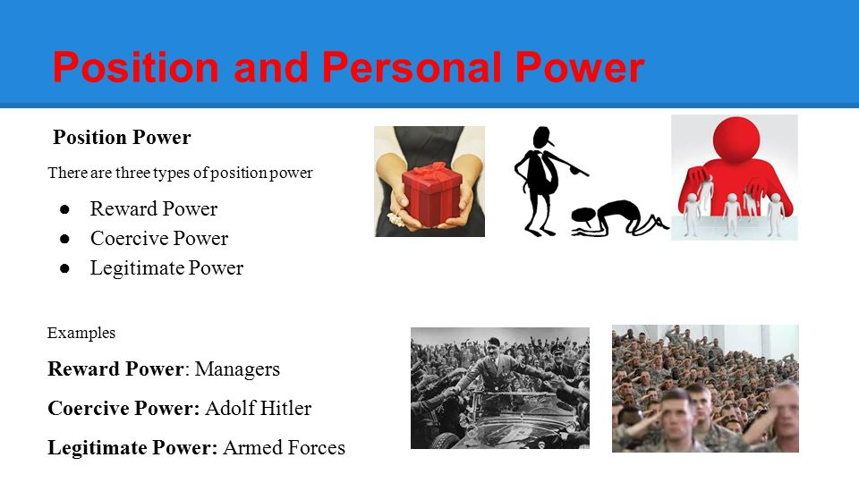

Slide 10
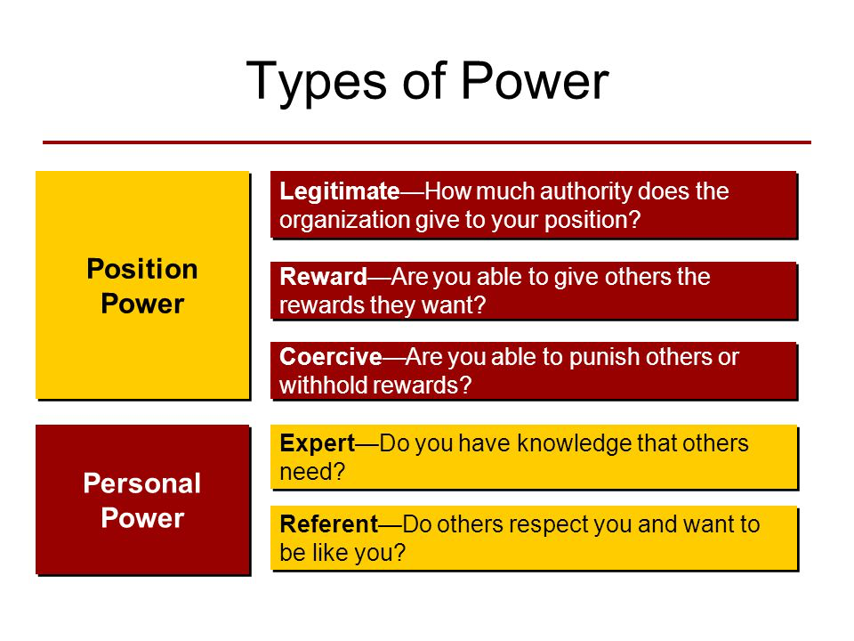

Slide 11
Types of Personal Power
Expert Power – do you have the knowledge that others need? IQ
Referent Power – do others respect you and want to be like you? AQ – ability to get over difficulties
Persuasive Power – do you have perfect communication skills? EQ – 5 senses
Charismatic Power – do you attract others by your character? Creative Intelligent Quotient

Slide 12
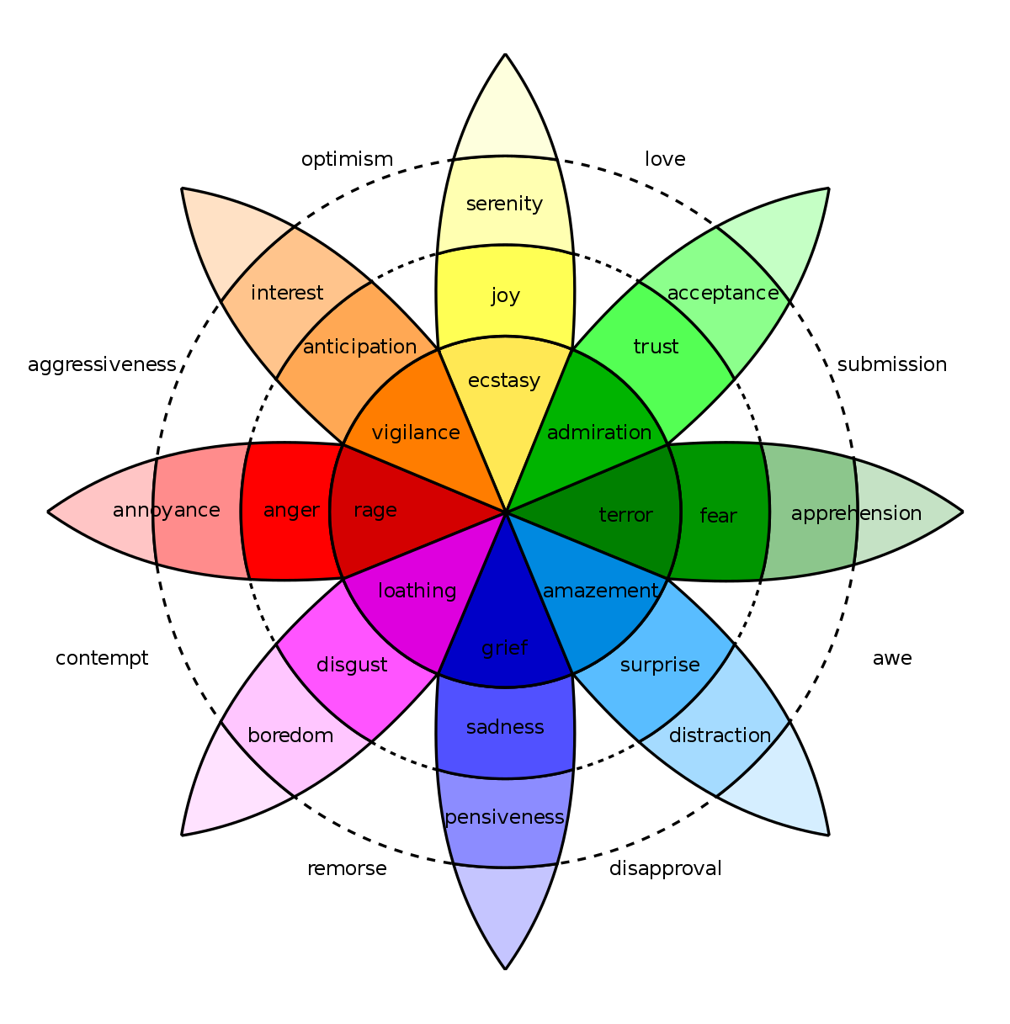

Slide 13
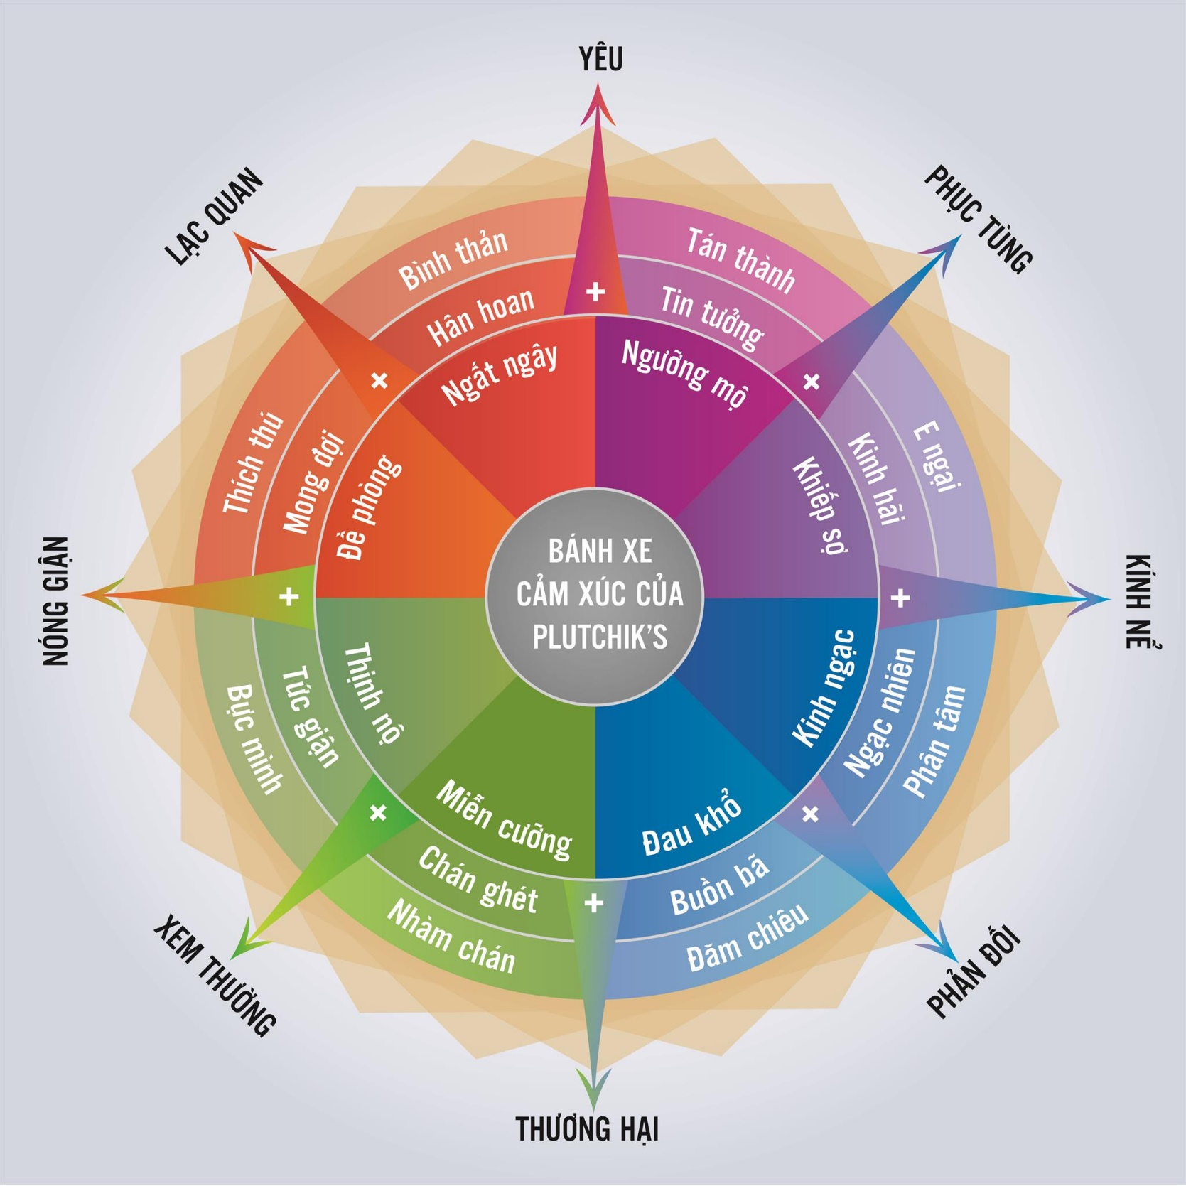

Slide 14
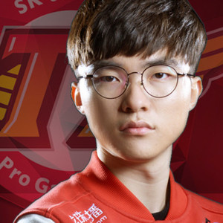
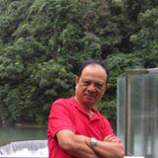
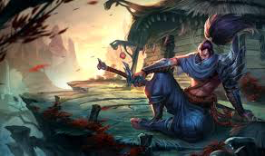
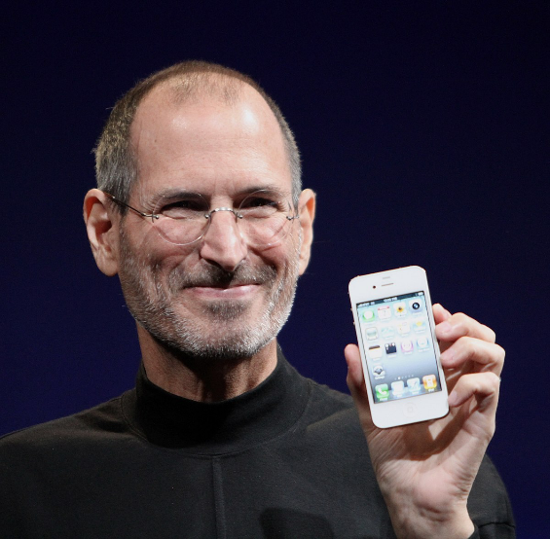
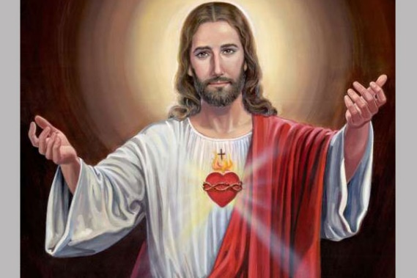
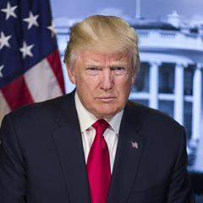
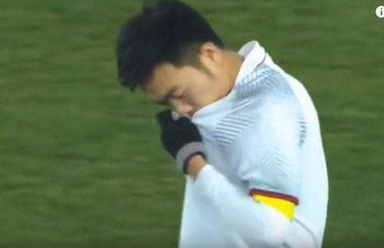
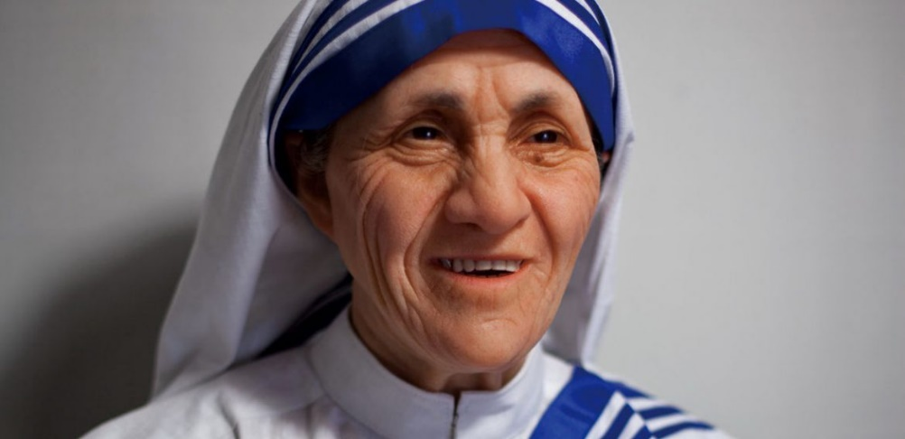
Charismatic
Expert/ Referent persuasive

Slide 15
Types of Personal Power
Expert Power – Relies on expertise and credentials/dignity
Referent Power – Relies on members’ high opinion of and experiences with the leader- relationship
Persuasive Power – Relies on effective communication skills
Charismatic Power – Relies on leader’s personal character, competence, & vitality

Slide 16
PowerPoint Quiz
At the end of every month, a sales manager awards a cash bonus to the most successful salesperson. What type of power is this leader using?
Referent power e) Expert power
Coercive power f) Informational power
Reward power g) Persuasive power
Legitimate power h) Charismatic power

Slide 17
PowerPoint Quiz
At the end of every month, a sales manager awards a cash bonus to the most successful salesperson. What type of power is this leader using?
Referent power e) Expert power
Coercive power f) Informational power
Reward power g) Persuasive power
Legitimate power h) Charismatic power

Slide 18
Becoming a Leader
Designated Leaders
Selected by group members or an outside authority
Being designated leader is no guarantee of leadership ability unless the leader’s skills match the group’s needs.
Emergent Leaders
Gradually achieve leadership by helping the group achieve its goals
Emerging from within a group has the advantage of relying on expert or referent power.

Slide 19
How to Become a Leader
Fill in the strategies for becoming a leader:
Talk early and often (and______________).
Know more (and ____________________).
Offer your opinion (and_______________).

Slide 20
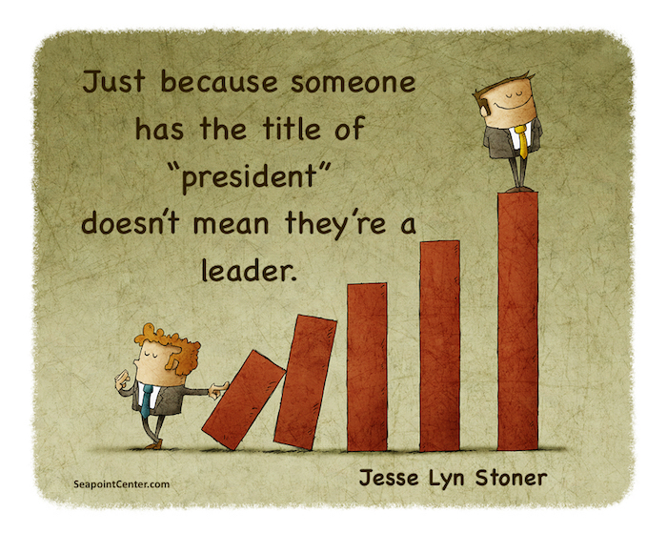
Does a title make a leader?

Slide 21
LMS – describe your favorite leader add pic
Position Power
Personal power: all types
Designated/emergent

Slide 22
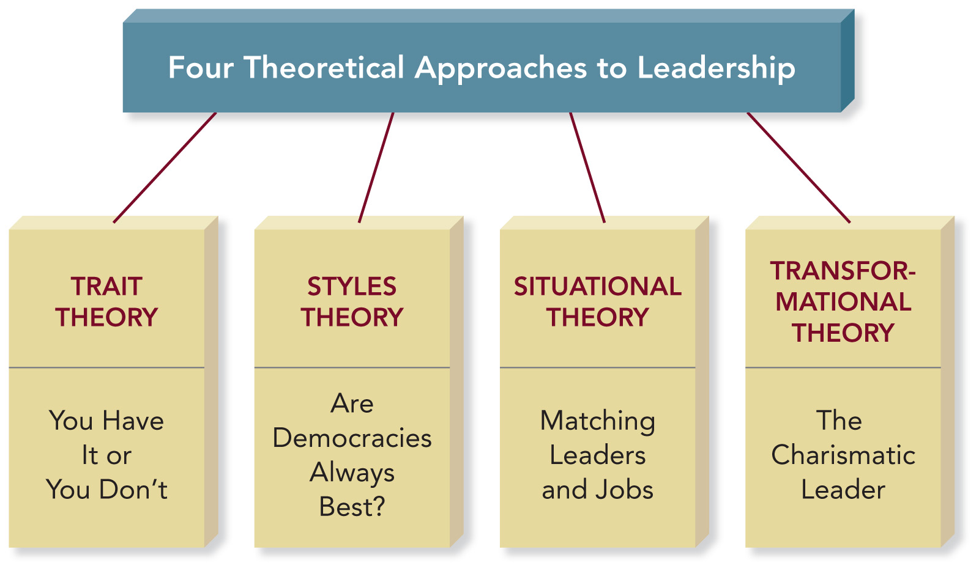
Leadership Theories

Slide 23
Trait Theory
Leaders are born, not made.
Identifies characteristics and behaviors of effective leaders.
Leadership Traits:
Self-confidence
Humility
Trustworthiness
Tolerance of frustration

Slide 24

Styles Theory
Democratic leaders are usually the best.
Autocratic leaders may be more effective in a crisis or chaotic situation.
Laissez-faire leaders may succeed in mature and highly productive groups.

Slide 25
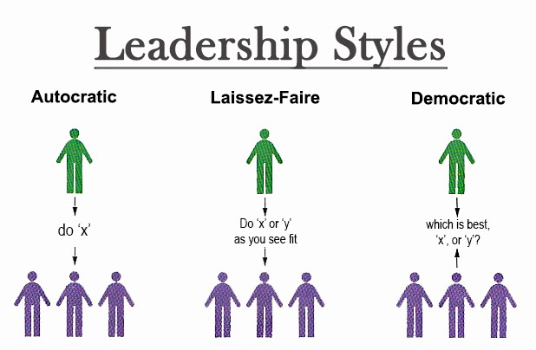
Styles Theory

Slide 26
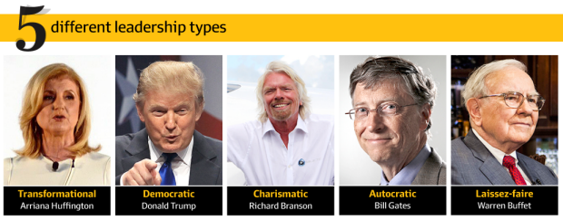
Autocratic

Slide 27
Situational Theory
Leaders are made, not born.
Fiedler’s Contingency Model of Leadership Effectiveness: Effective leadership occurs only when there is an ideal match between the leader’s style and the group’s work situation.
Hersey-Blanchard’s Situational Leadership Model: Leadership style adapts to the level of member readiness.

Slide 28
Contingency Model of Leadership
What is Your Leadership Style?
Are You Task Motivated? Do you want to get the job done at whatever cost.
Are You Relationship Motivated? Do you gain satisfaction from working well with other people even if the group neglects or fails to complete the task.

Slide 29
Contingency Model of Leadership
What Is the Leadership Situation?
Are leader-member relations positive, negative, or somewhere in between?
Is the task highly structured, moderately structured, or unstructured?
Does the leader have a lot of power, moderate power, or little power?

Slide 30
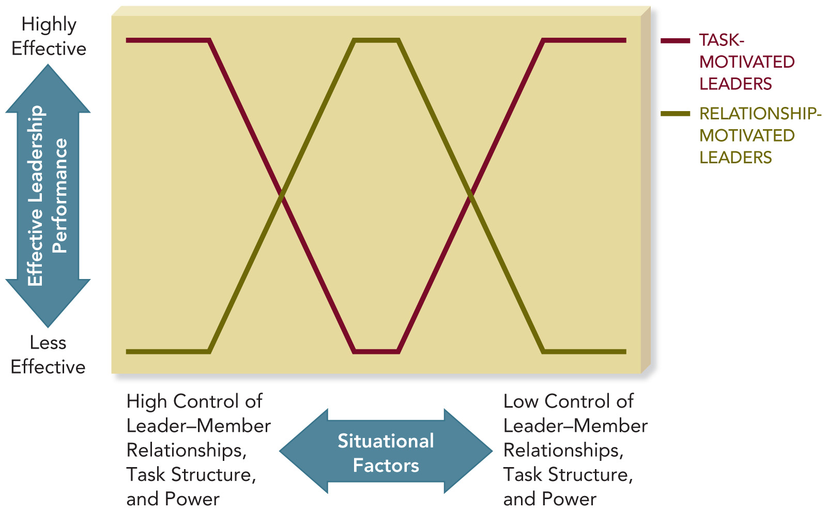
Contingency Model

Slide 31
Implications of the Contingency Model
Change the situation to your leadership style, rather than changing your leadership style.
You may need to gain group trust and support.
You may need to modify the amount or type of power you have and the structure of the task.

Slide 32
Hersey-Blanchard’s Situational Leadership Model (p.91)
Leaders adapt their leadership style to the level of member readiness.
Member Readiness: The extent to which group members are willing and able to work together to achieve a common goal.

Slide 33
Hersey-Blanchard’s Model
As a group’s readiness increases, leaders should rely more on relationship behavior than task behavior.
The Telling Stage: Low Readiness
The Selling Stage: Moderate Readiness
The Participating Stage: Moderate to High Readiness
Delegating Stage: High Readiness

Slide 34
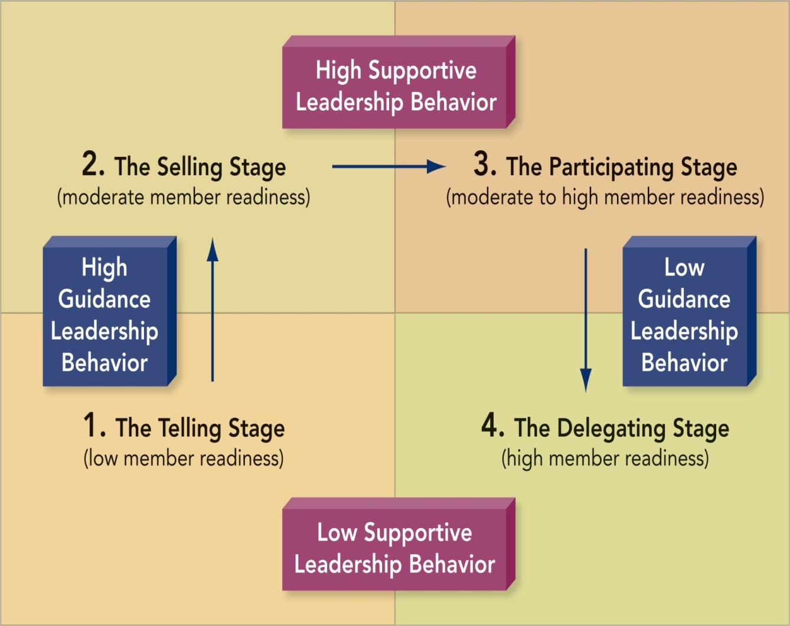
Hersey-Blanchard’s Model

Slide 35
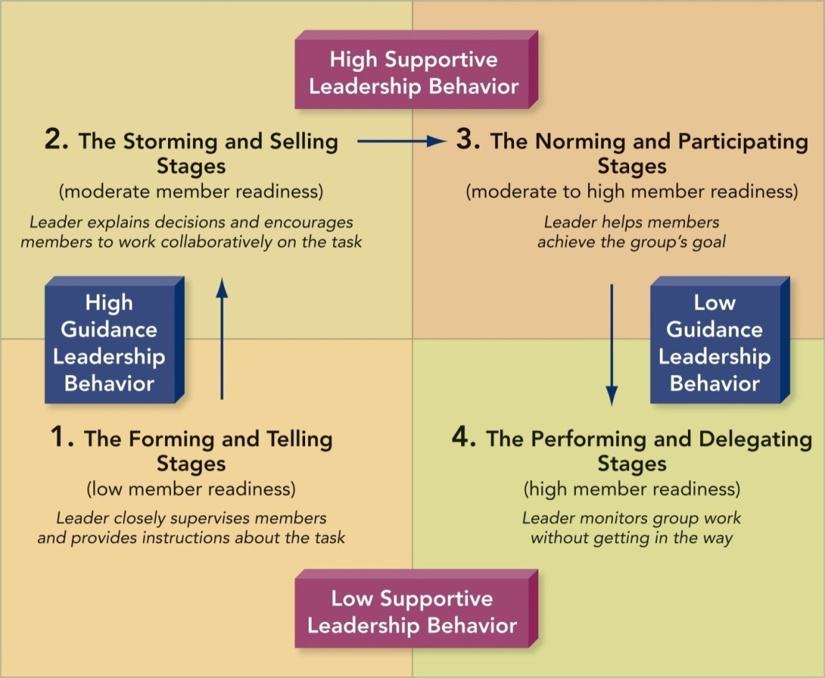
Group Development and Leadership Stages

Slide 36
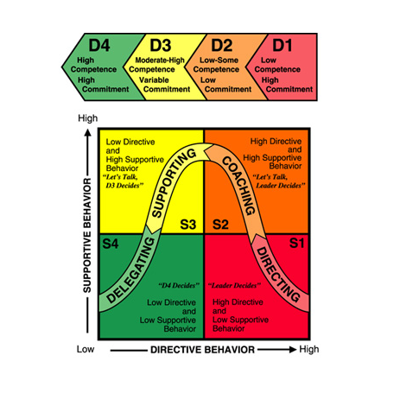
Know your members
Hersey-Blanchard’s Model

Slide 37
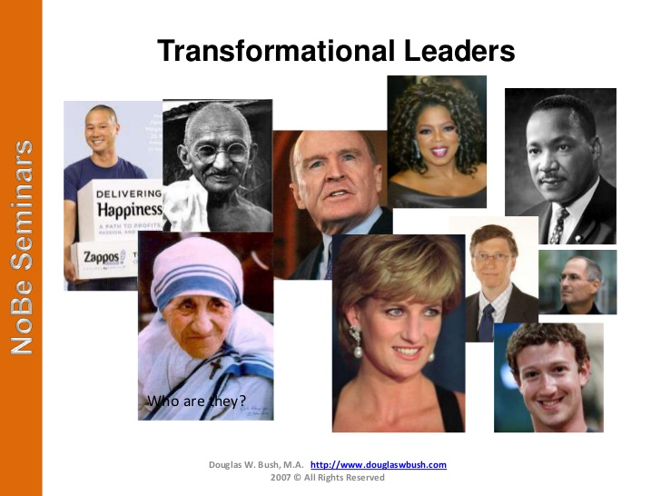

Slide 38

Transformational Theory
Emphasizes what leader accomplishes, not their personal characteristics or relationships with group members
Convert goals => action.

Slide 39
Transformational Leadership Characteristics
Charismatic
Visionary
Supportive
Empowering
Innovative
Modeling

Slide 40
5-M Model of Leadership Effectiveness
Interdependent Leadership Functions:
Model leadership behavior
Motivate members
Manage group process
Make decisions
Mentor members

Slide 41
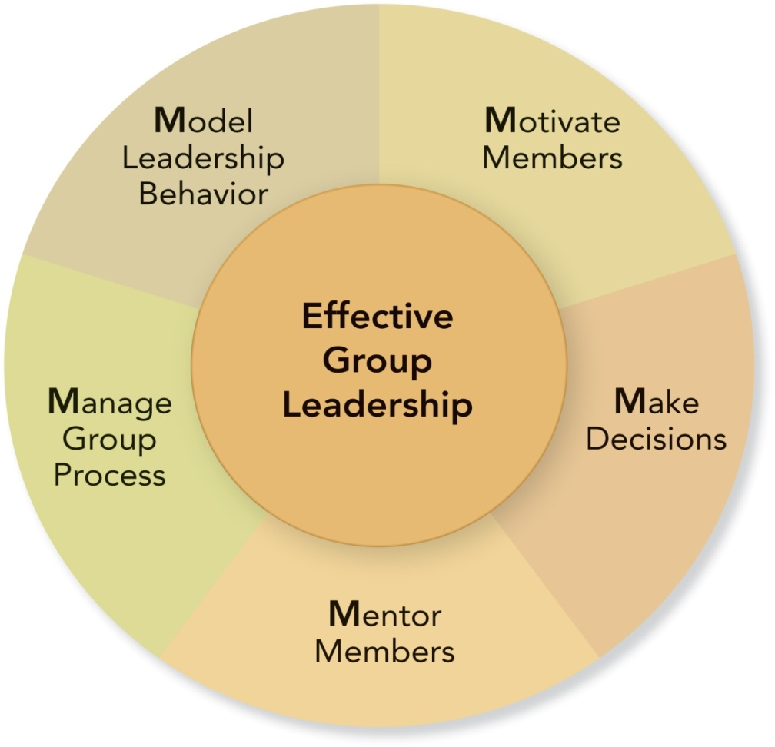
5-M Model of Leadership Effectiveness (p. 94)
Which one is most important?
Which one does a leader need to do all the time?

Slide 42
What is missing in 5M model leadership: mentor, model, motivate, make decision, …......?
A. mama
B. ma
C. manage
D. meomeo

Slide 43
Gender and Leadership
“Although male and female leaders may act the same, there is a tendency for women to be perceived more negatively or to have to act differently to gain leadership.”
Instead of asking whether a female leader is different than a male leader, ask whether she is an effective leader.
Rodney Napier and Matti Gershenfeld
Groups: Theory and Experience

